Slide 1

Web Fundamentals
HTML and CSS
Notes:
Short overview of topic…

Slide 2
Relative links
Notes:
Short overview of topic…

Slide 3
Objectives
In this chapter, you will learn:
That web sites consist of many files, often in a complex folder structure
How to reference other files on your web site, in images and in hyperlinks
Other places you can put your CSS besides the <head> section

Slide 4
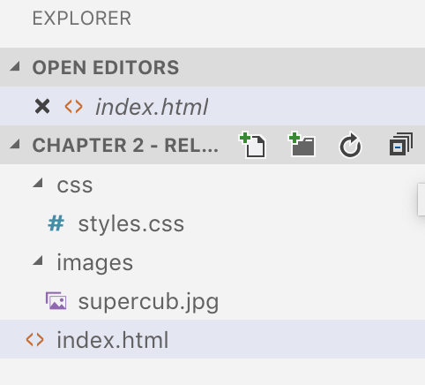
Folders
Web sites often have folders and sub-folders, just like the documents on your computer

Slide 5

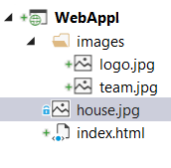
Relative and absolute path
Image in the same folder as the html page:
<img src="house.jpg" alt="Image of house" />
Image in the images sub-folder where the html page is located:
<img src="images/team.jpg" alt="QA team picture" />
Image in root folder:
<img src="/images/logo.jpg" alt="QA logo" />
Image from a URL:
<img src="http://qa.somee.com/html/slides/team.jpg" alt="QA team picture" />
If the URL begins with http:// or similar, it is a link to another website
If it begins with a / then it is relative to the web site’s home folder
If it does not begin with either of these, it is relative to the current folder

Slide 6
Inline CSS
So far, we have seen internal style sheets.
There are two other places you can put your CSS
The first of these is “inline”
This means the CSS is part of the tag
The CSS applies only to the tag where it is inlined:
Add a “style” attribute to a tag
The value of this attribute is made up of CSS property/value pairs
Example:
<p style="color:blue;font-style:italic">
This paragraph is blue and italic

Slide 7
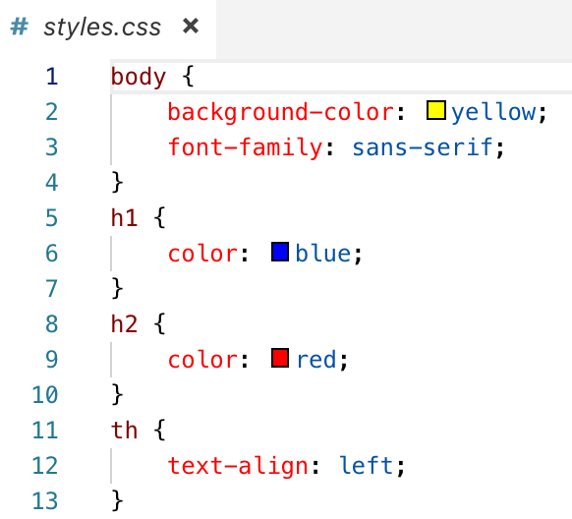
External style sheets
You can put CSS is in an external style sheet
A file with a .css extension
Can be on another website, or on the same website (relative link)
Has the same format as internal CSS
But without the <style> tags
To include a stylesheet in your page:
Note:
<link> appears instead of <style>
The “rel” attribute is required
<link rel="stylesheet" href="styles.css">

Slide 8
In this chapter, you learned:
That web sites consist of many files, often in a complex folder structure
How to reference other files on your web site, in images and in hyperlinks
Other places you can put your CSS besides the <head> section
Summary

Slide 9
Lab
In this lab, you will take the page you created during pre-learning, and you will:
Change the image so that instead of being on another website, it uses a relative link to access a copy on your own website
Change the CSS so it uses an external stylesheet
Chapter 2 - Relative Links.docx

